Slide 1
Welcome: CloudCME® RSS Coordinators Training August 21, 2024 | 12:00 pm
Dr. Annette Mallory Donawa Jennifer Turner, CA
Associate Provost, OCPD Education Program Specialist, OCPD
Sarah J. Carmody, MBA, CPTD
Associate Director, OCPD

Slide 2
Today’s Agenda
Annual Evaluation Fiscal Year 23-24
Annual Accreditation billing fees October 2024
Forward the new charge code number by August 30th

Slide 3
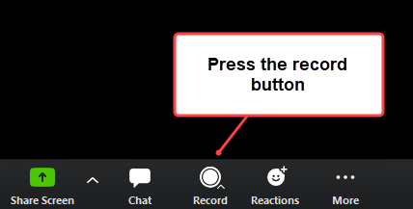
OCPD RSS Bi-monthly Meetings Schedule AY23-24 |12:00-1:00 pm
Date
September 20th
November 15th
January 17th
March 15th
May 8th
June 5th
August 21st | Evaluation
September 18th

Slide 4
Regularly Scheduled Series (RSS) Annual Evaluation
Mid-August 2024 through CloudCME
August 19th through October 15th, 2024
Survey is assigned to each RSS
My CE
Select Evaluations and Certificates
Notifications are sent to the learner every Monday via CloudCME until October 15th
The same questions apply to all regularly scheduled series
Please share survey results from your department

Slide 5
Jefferson.cloud-cme.com

